Slide 1
ADAMA SCIENCE AND TECHNOLOGY UNIVERSITY
ENGINEERING DRAWING (MEng 1102)
CHAPTER 1: INTRODUCTION

Slide 2
CONTENTS
Definitions
History of Technical Drawing
Importance/purpose of engineering drawing
Drawing instrument and their use
Technical lettering
Alphabet of line
Dimensioning principle

Slide 3
Objective
Define drawing and explain its advantage for technical communication.
Identify drawing instruments, able to care and properly handle them.
Explain the meaning of basic line types and their uses.
Identify lettering standard and practice how to write.
Enables blue print reading.

Slide 4
Definitions: What is drawing?
Drawing is:
A graphic representation of a real thing, an idea, or a proposed design for later manufacture or construction.
A graphic that represents an idea, a concept, or an entity which actually or potentially exists in life.
A way of communicating all necessary information about an abstraction such as an idea or a concept.

Slide 5
Importance of engineering drawing
As means of communication.
As the idea becomes technical the usual means of communication (talk or listen, read or write) will be less exact. For this reason visual language is developed to be technical and accurate means communication. This visual language in broad term is called graphic language.
As an engineering drawing displays the exact picture of an object, it obviously conveys the same ideas to every trained eye. Irrespective of language barriers, the drawings can be effectively used in other countries,
Thus, the engineering drawing is the universal language of all engineers.

Slide 6
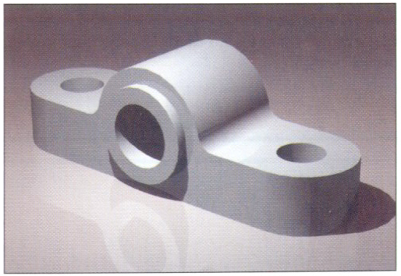
Effectiveness of Graphics Language
1. Try to write a description of
this object.
2. Test your written description
by having someone attempt to make a sketch from your
description.
You can easily understand that …
The word languages are inadequate for describing the size, shape and features completely as well as concisely.
6

Slide 7
Basic Elements of Engineering Drawing
Graphics
language
and
Word
language
Lettering
Line
types
Projection
method
Geometric
construction

Slide 8
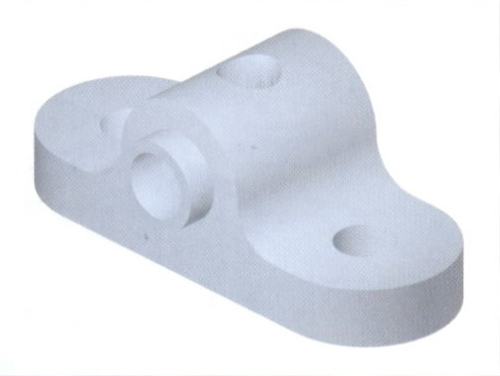
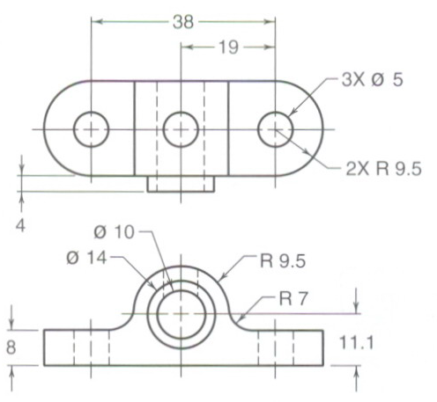
Cont.…
Engineering drawing are made up of graphics language and word language.
Graphics
language
Describe a shape (mainly).
Word
language
Describe size, location and specification of the object.

Slide 9
Composition of Graphic Language
Graphic language in “engineering application” use lines to represent the surfaces, edges and contours of objects.
This language is known as “drawing” or “drafting”
A drawing can be done by freehand, or using instruments or computer methods.

Slide 10
Freehand drawing
The lines are sketched without using instruments other than pencils and erasers. example
example
Example

Slide 11
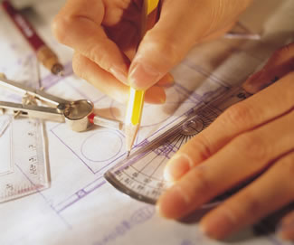
Instrument drawing
Instruments are used to draw straight lines, circles, and curves concisely and accurately. Thus, the drawings are usually made to scale.
Example

Slide 12
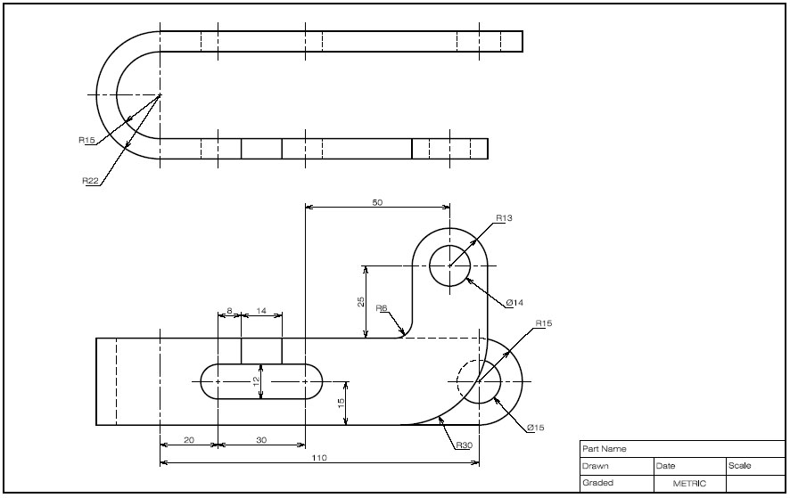
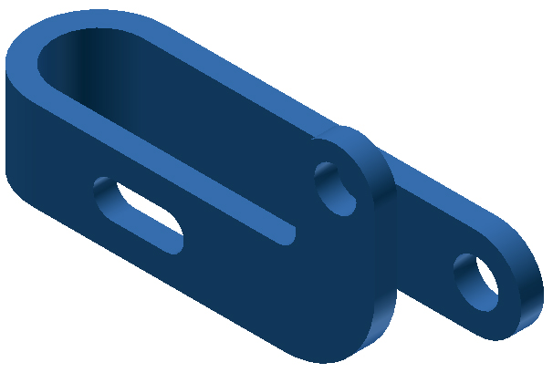
Computer drawing method
The drawings are usually made by commercial software such as AutoCAD, solid works and Catia etc.
Example
2D drawing
Solid modeling

Slide 13
Principles in engineering drawing
There are two principles in drawing
Visualization
The ability to see what an object looks like in the mind of eye.
Implementation
Drawing of an object that has been visualized.

Slide 14
Types of technical drawing
Drawing
Artistic
Technical
Sketches
(Conceptual)
Diagrams
(Design & Technical)
Engineering Drawings
(Technical)
Less technical More technical

Slide 15
Technical drawing must communicate the same message to every user or reader of the drawing, whereas an artistic drawing is usually interpreted differently by everyone who sees it.
Engineers: People who use technical means to solve problems. They design products, systems, devices, and structures to improve our living conditions.

Slide 17
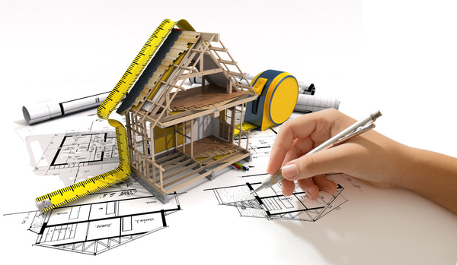

Slide 19
History of Engineering Drawing:
Drawing is one of the oldest forms of communication, dating back even further than the verbal communication.
Historically drawing is started by the caveman.
He uses it for communication to lead his day to day life.
Egyptian hieroglyphics also play its own role for the development of drawing.
Leonardo da Vinci prepared mechanical drawings showing orthographic views as we do now.

Slide 20
As human needs increase continuously, there is revolutionary change. Industrial revolution is one of the milestones for the development of drawing.
From time to time several rules and principles are developed to utilize drawing as efficient as possible.
It is about 1749 that, the drawing with the current conventional representations came into existence by Washington DC civil engineers.

Slide 21
Engineering Drawing In Design Process

Slide 22
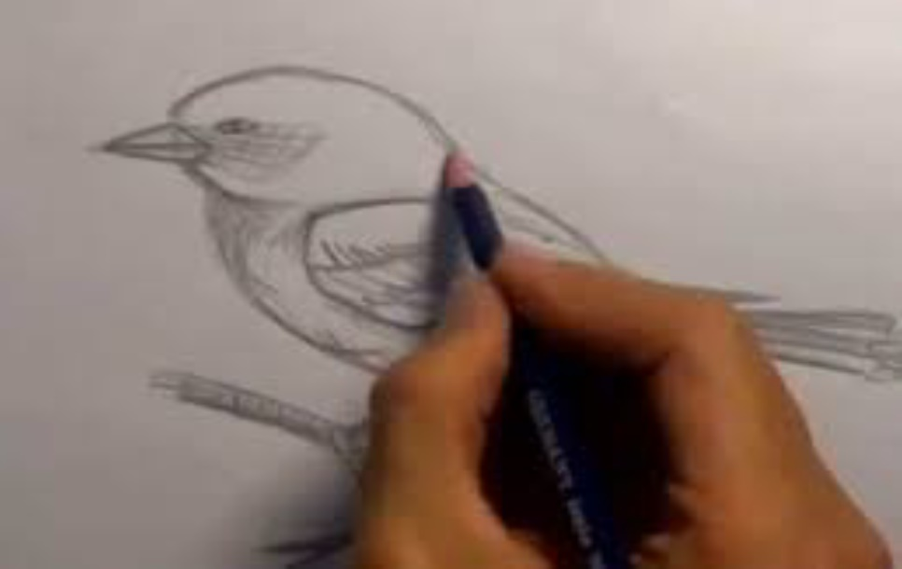
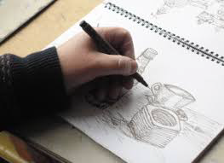
Sketch: made without drawing tools... Just pencil and paper. Scale is approximate, not accurate, but the sketch should still look like the object.
Engineering Drawing: Made with drawing tools... Ruler, set squares, protractor and compass. Scale should be accurate and the drawing should be prepared carefully.

Slide 23
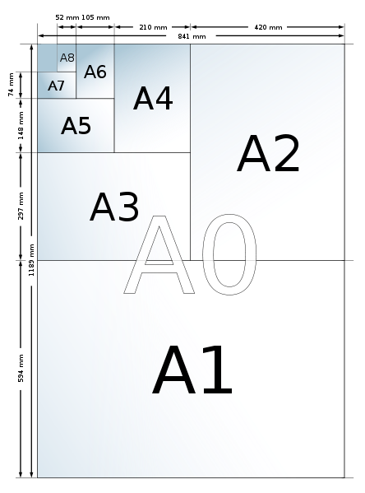
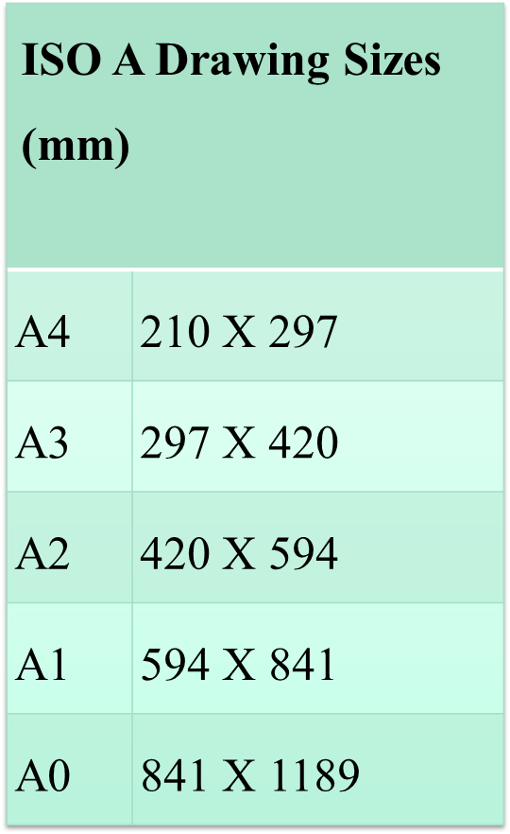
Drawing Sheet :
Standard size
c paper

Slide 24
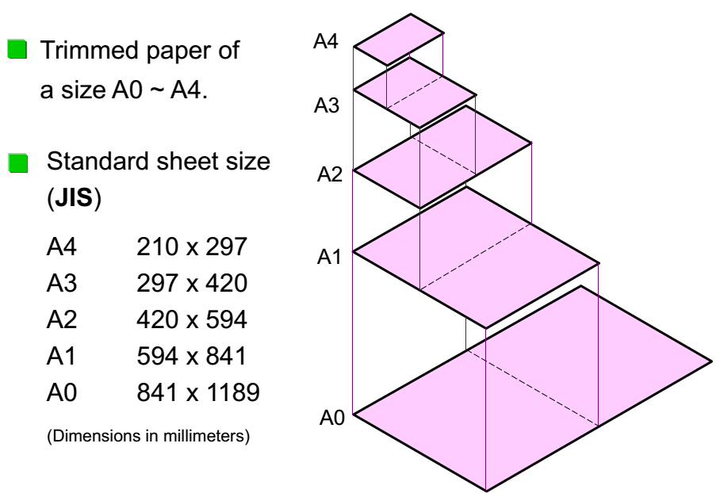
Cont.…

Slide 25
Orientation of drawing sheet
2. Type Y (A4 only)
1. Type X (A0~A4)
c
d
c
Drawing
space
Title block
d
c
Border
lines
Drawing space
Title block
c

Slide 26
Drawing paper:
The following elements to be noticed over the format of our drawing paper:
Border line: it is the peripheral heaviest lines which enclose all drawings.
Title Block: It is a box where all information about the drawing such as drawn by, checked by, date, scale, title of drawing, drawing number and company name are specified.
Guide line: is the lightest line used to guide the height of alphabets.

Slide 27
105

Slide 28
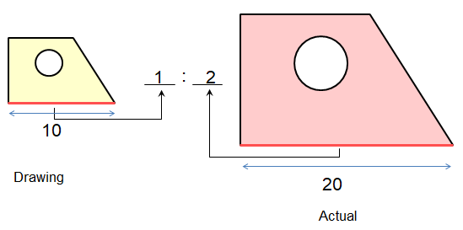
Drawing Scales
Scale: is a ratio between the linear dimension(size) of a drawn representation of an object and the actual object.

Slide 29
Designation of a scale consists of the word “SCALE” followed by the indication of its ratio, as follows.
SCALE 1:1 for full size
SCALE X:1 (X > 1) for an enlargement scales
SCALE 1:X (X > 1) for a reduction scales

Slide 30
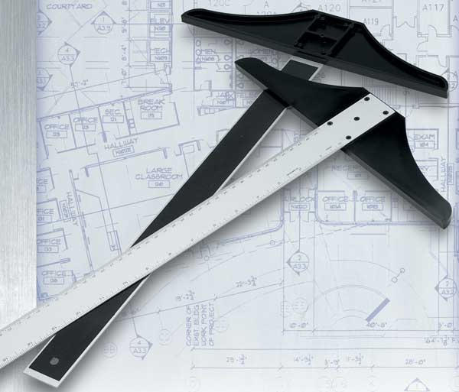
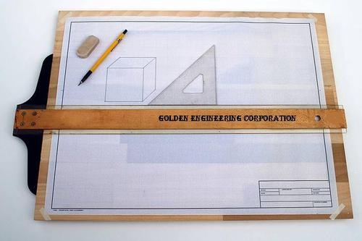
Drawing instruments and their use

Slide 31
Drawing instruments:
The preparation of technical drawing is possible only through knowledge and skill in the use of a variety of instruments.
With the aid of knowledge and skill practice it is possible to bring perfection!

Slide 32
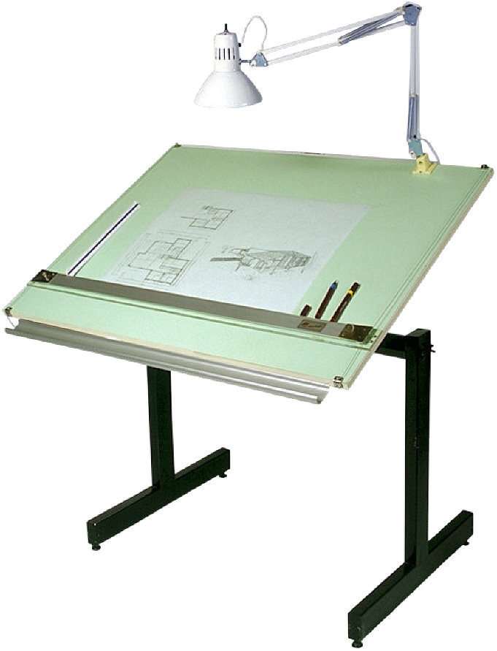
Drawing board
Drawing board is made from strips of well seasoned soft wood generally 25 mm thick. One of the shorter edges of the rectangular board is provided with perfectly straight ebony edge which is used as working edge on which the T-square is moved while making Drawings.
Notes:
Exchange of ideas needs means of communication.

Slide 33
Drawing pencils
Selection of drawing pencil
type and quality of drawing paper
how thick and dark you want the line to be.
Pencil lines should be clean and sharp. They must be dark enough for the views to be seen when the standard lines are drawn.
If you use too much pressure, you will groove the drawing surface. You can avoid this if you use proper grade of lead.
Turn the pencil between your thumb and forefinger as you draw a line.
Notes:
Exchange of ideas needs means of communication.

Slide 34
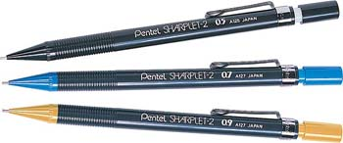
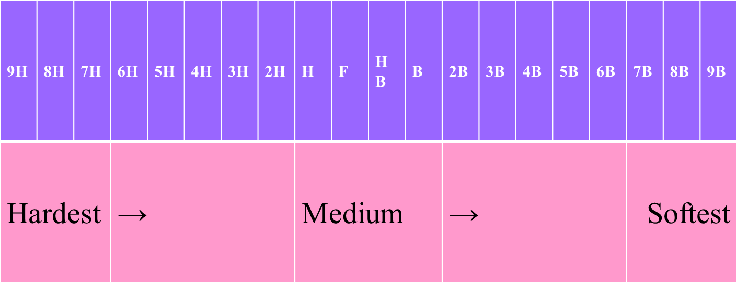
Pencils:
2H or HB for thick line
4H for thin line

Slide 35
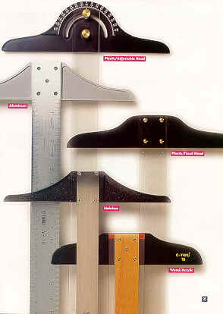
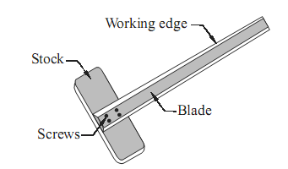
T-square
They can be made from different materials, mostly wood or plastic.
parts: blade and head
The head is fixed at 90⁰ to the blade.
The head is made to slide along the working edge and the Blade moves on the Drawing board. Used for Drawing horizontal lines, Guiding triangles, Position drawing paper
The cleanness of your T –square greatly affect your drawing quality and cleanliness.
Notes:
Exchange of ideas needs means of communication.

Slide 36
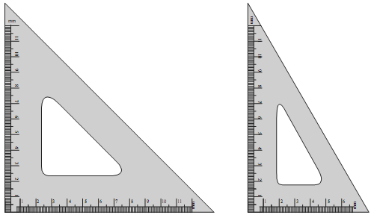
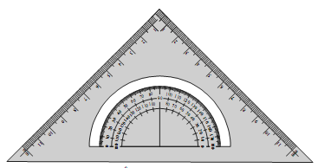
Set square
Set squares are generally made from Plastic or celluloid material. They are triangular in shape with one corner, a right angle triangle. A pair of set squares (30°–60°) and 45° (45° set square are generally provided with Protractor) facilitate marking of angles.
They are used to draw lines at 30°, 60° and 45° to the vertical and horizontal
45 Set Square
30-60 Set Square
45 Set Square with Protractor
Notes:
Exchange of ideas needs means of communication.

Slide 37
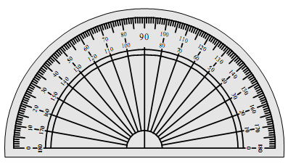
Protractor
Protractors are used to mark or measure angles between 0 and 180°. They are semicircular in shape (of diameter 100mm) and are made of Plastic or celluloid which has more life.
Protractors with circular shape capable of marking and measuring 0 to 360° are also available in the market.
Notes:
Exchange of ideas needs means of communication.

Slide 38
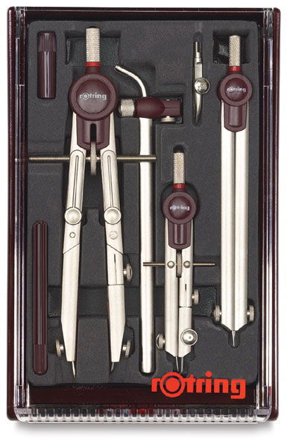
Drawing Instrument Box
It consists of the following
a) Large size compasses,
b) Large size divider,
c) Small size bow pen, bow divider, and
d) Lengthening bar.
Notes:
Exchange of ideas needs means of communication.

Slide 39
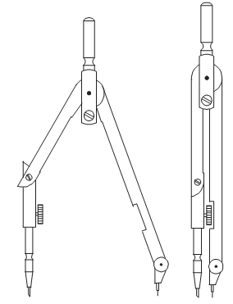
Compass
Compass is used for drawing circles and arcs of circles. The compass has two legs hinged at one end. One of the legs has a pointed needle fitted at the lower end where as the other end has provision for inserting pencil lead. Circles up to 120mm diameters are drawn by keeping the legs of compass straight. For drawing circles more than 150 mm radius, a lengthening bar is used.
It is advisable to keep the needle end about 1mm long compared to that of pencil end so that while drawing circles, when the needle end is pressed it goes inside the drawing sheet by a small distance (approximately 1mm).
Notes:
Exchange of ideas needs means of communication.

Slide 40
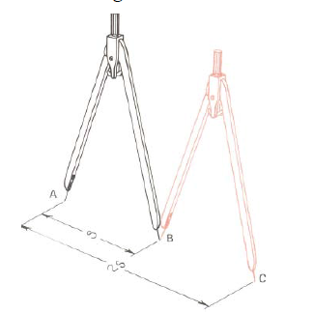
Divider
A divider is a drawing instrument used for dividing distances into equal parts or for laying off a series of equal spaces.
Divider

Slide 41
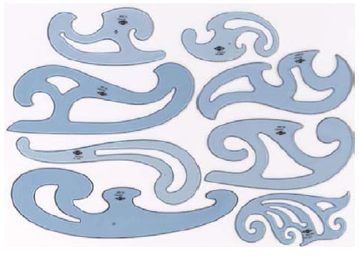
French Curve
When it is required to draw mechanical curves other than circles or circular arcs, a French curve is generally employed. Many different forms and sizes of French curves are manufactured, as suggested by the more common forms. The curves are composed largely of successive segments of the geometric curves, as the ellipse, parabola, hyperbola, involutes, etc.
French curves

Slide 42
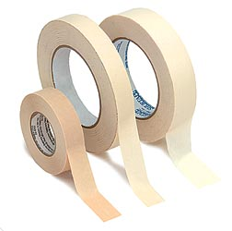
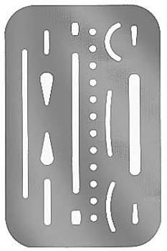
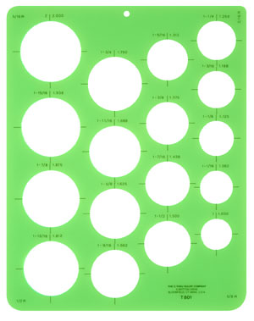
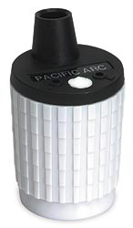
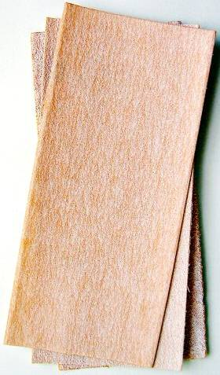
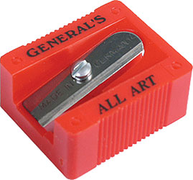
Other instrument
Adhesives tape
Pencil eraser
Erasing shield
Tissue paper
Pencil sharper
Paper cleaner
Circle template
Sand paper
Notes:
Exchange of ideas needs means of communication.

Slide 43
Lettering

Slide 44
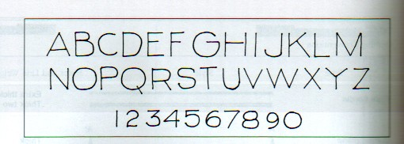
Lettering
Lettering is used on drawings to give dimensions and other pertinent information needed to fully describe the item. To communicate nongraphic information.
The lettering must be neat and legible in order to be easily read and understood.

Slide 45
Lettering Standard
ANSI Standard
This course
Use a single stroke Gothic text style, either inclined or vertical.
Use only a vertical Gothic
text style.
Use both capital and
lower-case letters.
Use all capital letters.
Use 3 mm for most
text height.
For letters in title block it is recommend to use 5~8 mm text height
Space between lines
of text is at least 1/3
of text height.
Follows ANSI rule.
45

Slide 46
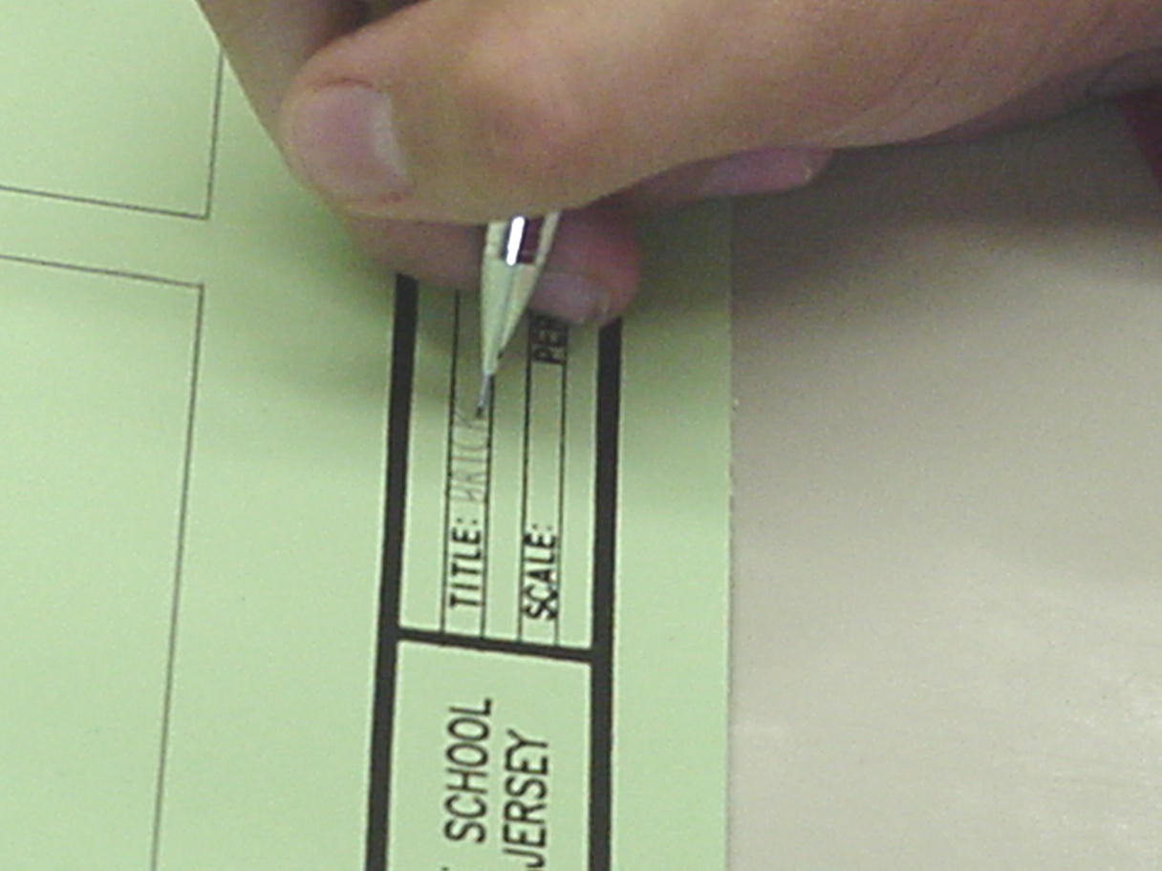
Cont.….
Most of the time it is recommended to use 3mm height of letters to write in the title block except title of the drawing which is slightly larger than the others, 5mm.
Between lines of sentences we use a gap of about 3/5th of the height of letters.
All words in title blocks should be written in upper case letters.

Slide 47
Cont.….

Slide 48
Cont.….
A drawing will be improved by good lettering.
However, a good drawing will look sloppy and unprofessional if the lettering is poorly done.

Slide 49
3.3.Basic Strokes
Straight
Slanted
Horizontal
Curved
Examples : Application of basic stroke
4
5
“I” letter
1
“A” letter
1
2
“B” letter
1
3
6
3
2
49

Slide 50
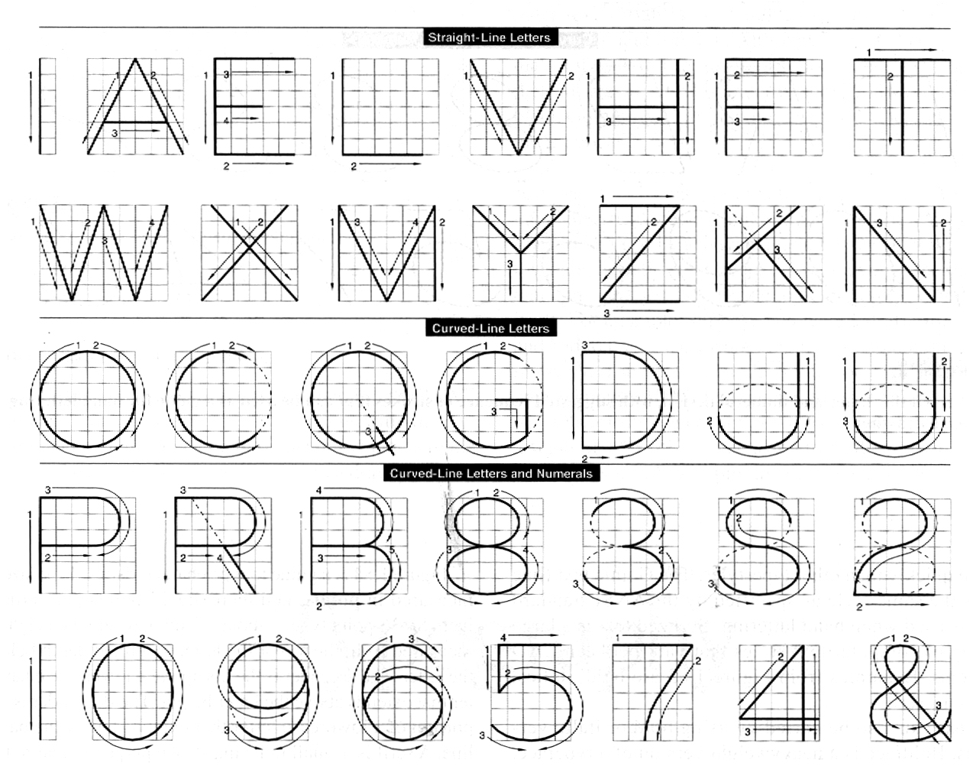
Suggested Strokes Sequence
A. Upper-case letters & Numerals
Straight and slanted line
letters
Curved line
letters
Curved line
letters &
Numerals
50

Slide 51
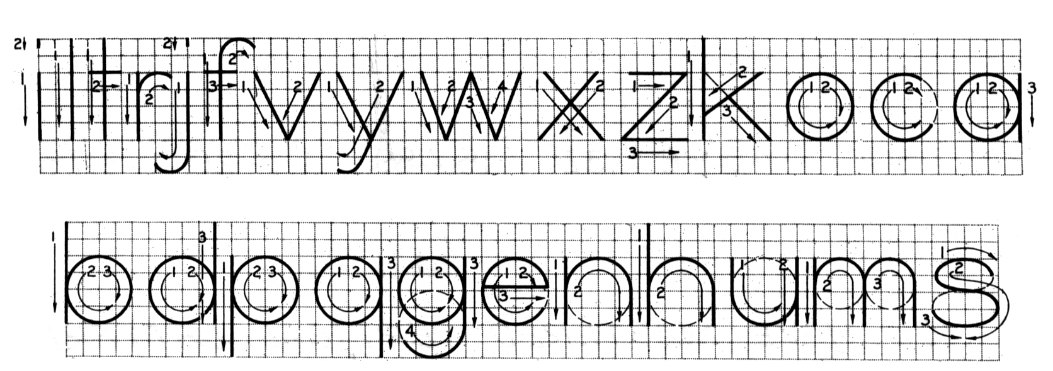
B. Lower-case letters
Suggested Strokes Sequence
The text’ s body height is about 2/3 the height of a capital letter.

Slide 52
Stroke Sequence
I
L
T
F
E
H
V
X
W

Slide 53
O
Q
C
G
5
7

Slide 54
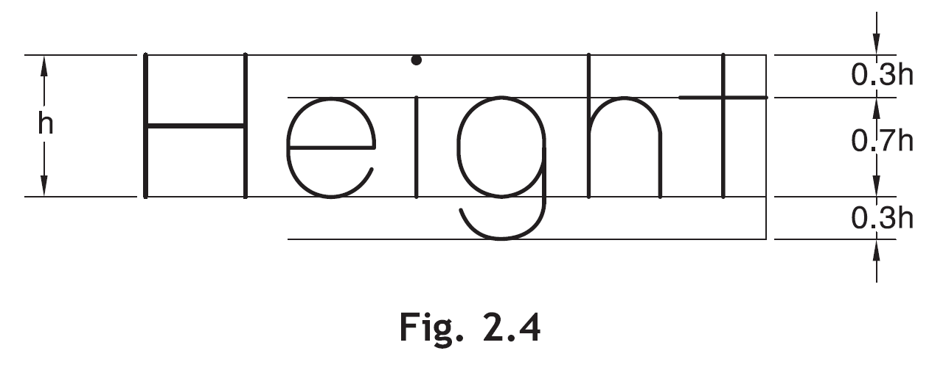
j
y
f
t
r

Slide 55
c
o
a
b
u
d
p
q
e
s

Slide 56
Sentence Composition
Leave the space between words equal to the space requires for writing a letter “O”.
Example
ALL
O
DIMENSIONS
O
ARE
O
IN
MILLIMETERS
O
UNLESSOAND
OOTHERWISE
O
SPECIFIED.

Slide 59
Line types

Slide 60
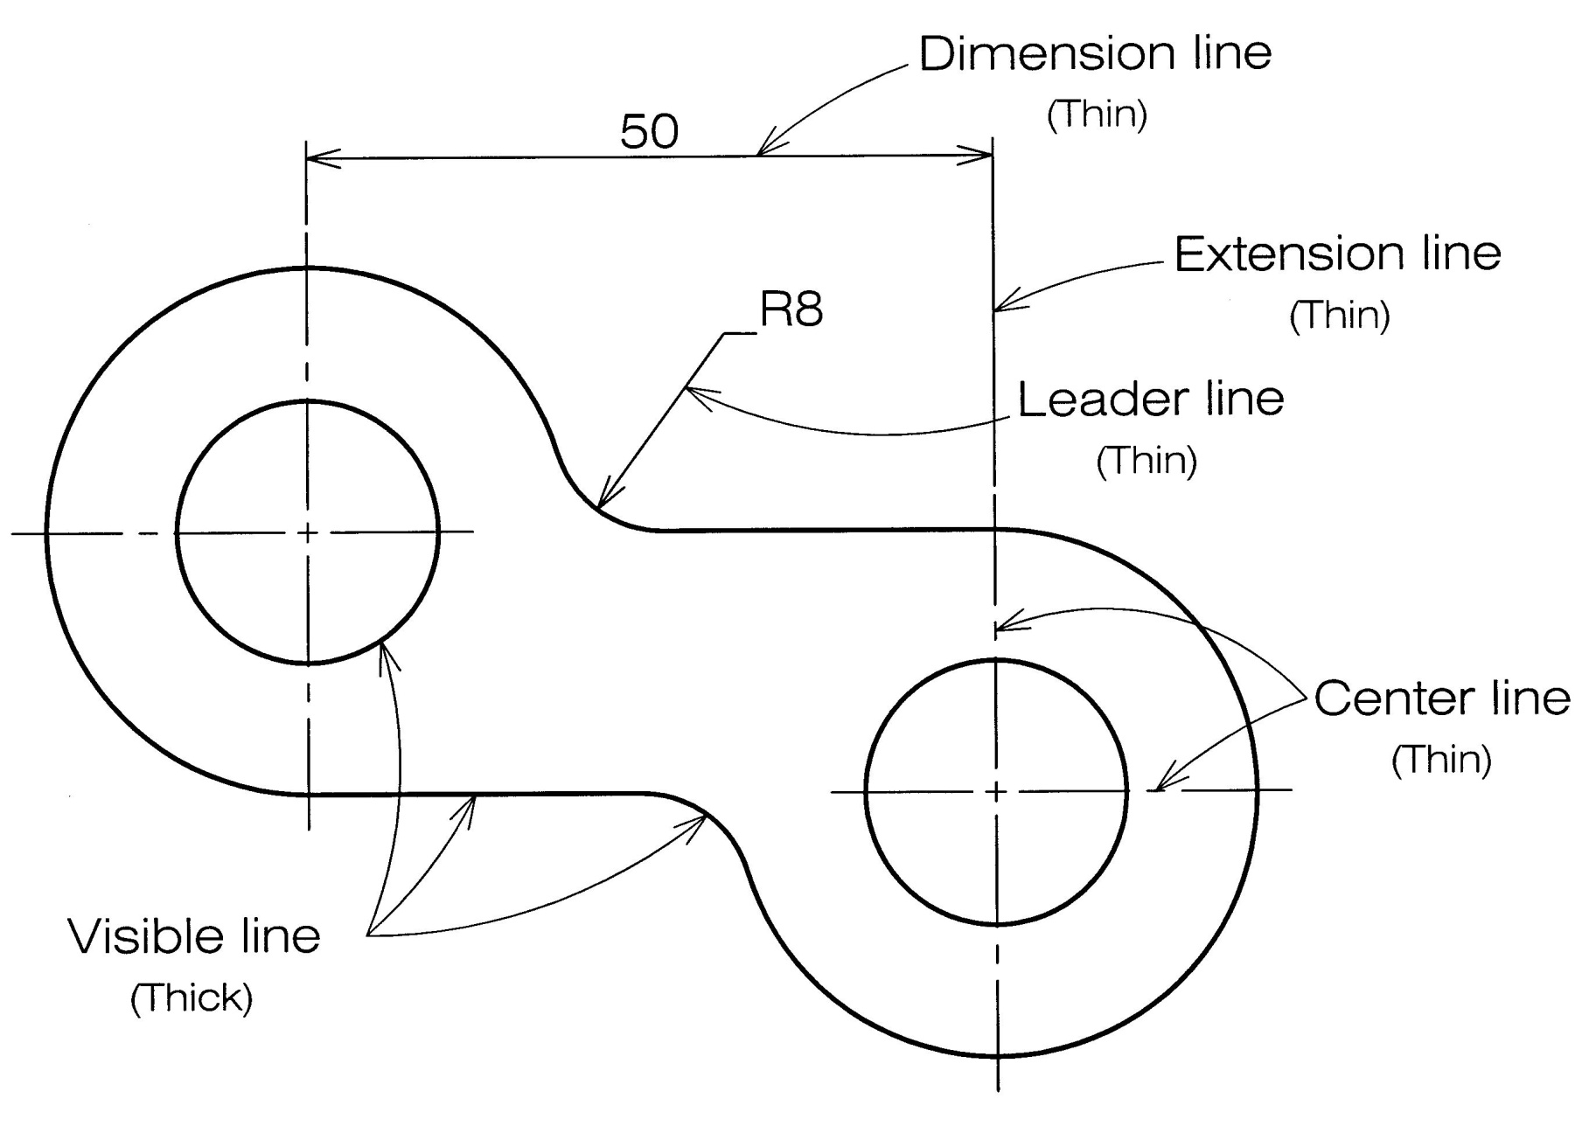
Basic Line Types
Example : Line conventions in engineering drawing

Slide 61
Example : Line conventions in engineering drawing

Slide 62
Dimensions in engineering drawing
Dimension is for size and position (of the designed/modeled shape).
A dimension is a numerical value expressed in appropriate units of measurement and used to define the size, location, orientation, form or other geometric characteristics of a part.
A method of communication to machinists in the Production facility.
Different kinds:–
Linear
Aligned
Angular
Radius/Diameter
Reference

Slide 63
Guide lines for dimensioning
1. All overall dimensions for the object are shown.
2. Dimensions are not duplicated in two views.
3. No dimension is included that is not needed to produce the object.
4. There is no need to calculate, scale, or assume any dimension to define or check features of the object.
5. Dimensions are related to the view that best shows the features being dimensioned.
6. Multiple rows of dimensions are spaced uniformly

Slide 64
Guide lines for dimensioning
7. Longer dimensions are placed outside shorter ones so that witness lines do not cross dimension lines.
8. All strings of dimensions are lined up.
9. Whenever possible, dimensions are not given to hidden lines.
10. Dimension lines do not cross other dimension lines or witness lines.
11. The radius of all arcs and fillets, and the diameters of all circles have been specified.

Slide 65
Example

Slide 66
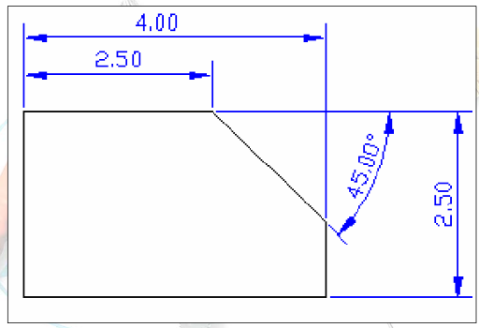
Dimensioning

Slide 69
Standards
Definition
Drawing standards are set of rules that govern how technical drawings are represented.
Drawing standards are used so that drawings convey the same meaning to everyone who reads them.

Slide 70
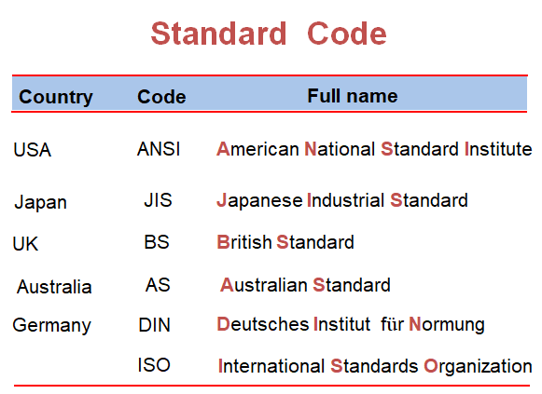

Slide 71
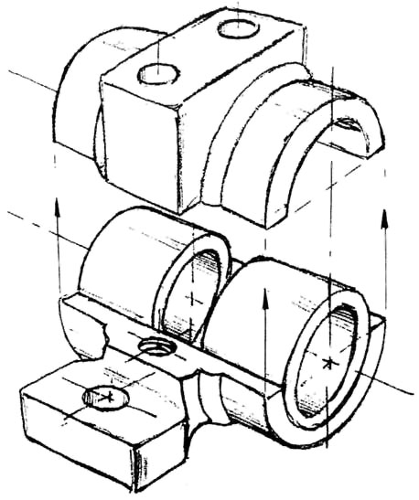
Freehand Sketching

Slide 72
Straight Line
1. Hold the pencil naturally.
2. Spot the beginning and end points.
3. Swing the pencil back and forth between the points, barely
touching the paper until the direction is clearly established.
4. Draw the line firmly with a free and easy wrist-and-arm motion

Slide 73
Horizontal line
Vertical line

Slide 74
Nearly vertical
inclined line
Nearly horizontal
inclined line

Slide 75
Small Circle
Method 1 : Starting with a square
1. Lightly sketching the square and marking the mid-points.
2. Draw light diagonals and mark the estimated radius.
3. Draw the circle through the eight points.
Step 1
Step 2
Step 3

Slide 76
Small Circle
Method 2 : Starting with center line
1. Lightly draw a center line.
2. Add light radial lines and mark the estimated radius.
3. Sketch the full circle.
Step 1
Step 2
Step 3

Slide 77
Large Circle
Place the little finger (or pencil’ s tip) at the center as a pivot, and set the pencil point at the radius-distance from the center.
Hold the hand in this position and rotate the paper.

Slide 78
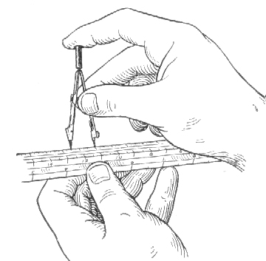
Using a compass
1. Locate the center of the circle to be drawn.
Draw two intersecting lines.
2. Adjust the distance between a needle and a lead to be a radius of the circle.
3. Set the needle point at the circle’s center.

Slide 79
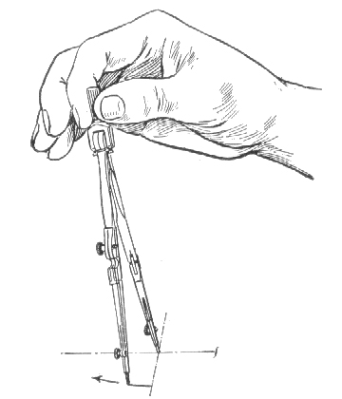
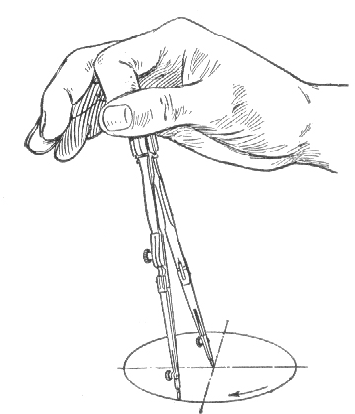
Using a compass
4. Start circle. Apply enough pressure to the needle, holding the compass handle between thumb and index fingers.
5. Complete circle. Revolve the handle clockwise.

Slide 80
Arc
Method 1 : Starting with a square
Method 2 : Starting with a center line

Slide 81
Example

Slide 82
THE END!!
….. CHAPTER 2
THEORY OF PROJECTION

